Slide 1
Drought Predictions
Carolyn Chu, Romario Leal, Amy Paschal, David Rodgers, Austin McClain

Slide 2
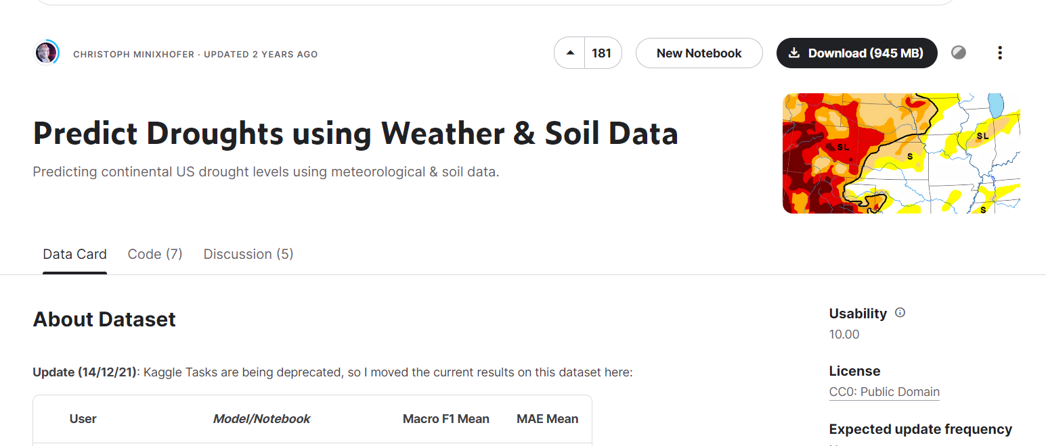
Data Set
https://www.kaggle.com/datasets/cdminix/us-drought-meteorological-data

Slide 3
Two Data Sets
Soil Data.csv
Shape: 3,109 rows, 32 columns
Description of the measurement sites
Time Series Data.csv
Shape: Over 23 million rows, 21 columns
Pre-Split between Training, Validation, and Test
Data on the weather conditions at each site over 20 years, and a drought score

Slide 4
Soil_data.csv
Fips: US county FIPS code. (Geocode for County)
Lat
Lon
Elevation: median elevation (meters)
Slope1: 0 % ≤ slope ≤ 0.5 %
Slope2: 0.5 % ≤ slope ≤ 2 %
Slope3: 2 % ≤ slope ≤ 5 %
Slope4: 5 % ≤ slope ≤ 10 %
Slope5: 10 % ≤ slope ≤ 15 %
Slope6: 15 % ≤ slope ≤ 30 %
Slope7: 30 % ≤ slope ≤ 45 %
aspectN: North: 0˚< aspect ≤45˚ or 315˚< aspect ≤360˚
espectE: East: 45˚ < aspect ≤ 135˚
aspectS: South: 135˚ < aspect ≤ 225˚
aspectW: West: 225˚ < aspect ≤ 315˚
aspectUnknown: Undefined: Slope aspect undefined; this value is used for grids where slope gradient is undefined or slope gradient is less than 2%.
WAT_LAND: mapped water bodies
NVG_LAND: barren/very sparsely vegetated land
URB_LAND: built-up land (residential and infrastructure)
GRS_LAND: grass/scrub/woodland
FOR_LAND: forrest land, calibrated to FRA2000 land statistics
CULTRF_LAND
CULTIR_LAND: irrigated cultivated land, according to GMIA 4.0
CULT_LAND: total cultivated land
SQ1: Nutrient availability
SQ2: Nutrient retention capacity
SQ3: Rooting conditions
SQ4: Oxygen availability to roots
SQ5: excess salts
SQ6: toxicity
SQ7: Workability

Slide 5
Time Series Data
(Used in Machine Learning Model)
Fips (County Number)
Date
PRECTOT: Precipitation (mm day-1)
PS: Surface Pressure (kPa)
QV2M: Specific Humidity at 2 Meters (g/kg)
T2M: Temperature at 2 Meters ©
T2MDEW: Dew/Frost Point at 2 Meters ©
T2MWET: Wet Bulb Temperature at 2 Meters
T2M_MAX: Maximum Temperature at 2 Meters
T2M_MIN: Minimum Temperature at 2 Meters
T2M_RANGE: Temperature Range at 2 Meters
TS: Earth Skin Temperature ©
WS10M: Wind Speed at 10 Meters (m/s)
WS10M_MAX: Maximum Wind Speed at 10 Meters (m/s)
WS10M_MIN: Minimum Wind Speed at 10 Meters (m/s)
WS10M_RANGE: Wind Speed Range at 10 Meters (m/s)
WS50M: Wind Speed at 50 Meters (m/s)
WS50M_MAX: Maximum Wind Speed at 50 Meters (m/s)
WS50M_MIN: Minimum Wind Speed at 50 Meters (m/s)
WS50M_RANGE: Wind Speed Range at 50 Meters (m/s)
Score: Measure of drought ranging from 0 (no drought) to 5 (D4, see description).

Slide 6
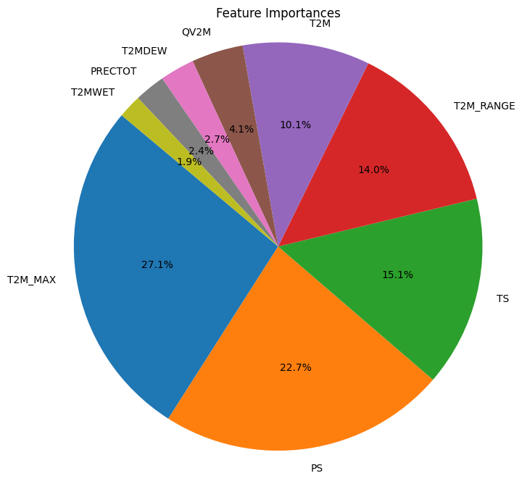
Important Features
T2M_MAX: Maximum Temperature at 2 Meters
T2MWET: Wet Bulb Temperature at 2 Meters
T2MDEW: Dew/Frost Point at 2 Meters
T2M: Temperature at 2 Meters
T2M_RANGE: Temperature Range at 2 Meters
TS: Earth Skin Temperature
PRECTOT: Precipitation (mm day-1)
QV2M: Specific Humidity at 2 Meters (g/kg)
PS: Surface Pressure (kPa)

Slide 7
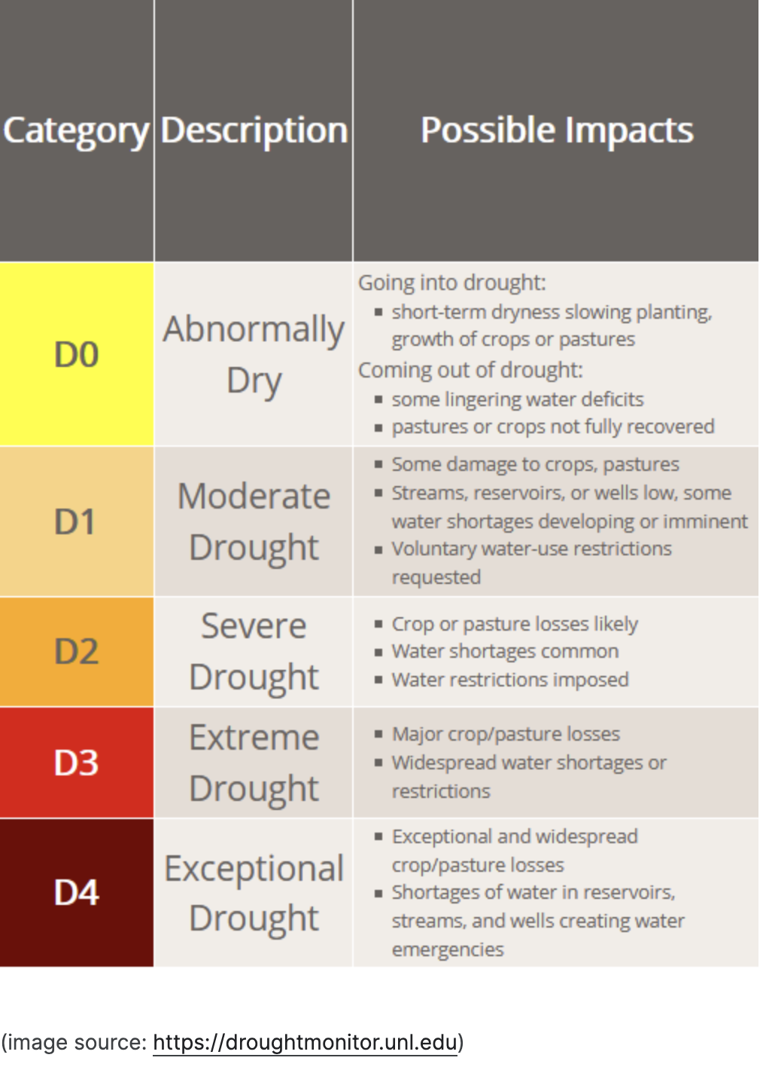
Target:
Drought Score
Image source:
https://droughtmonitor.unl.edu

Slide 8
Tools Used
PySpark - Because of the large dataset
PySpark / SQL
Tableau - Used to create interactive map
Google Drive - To host data
Pandas
Matplotlib.pyplot
GeoPy

Slide 9
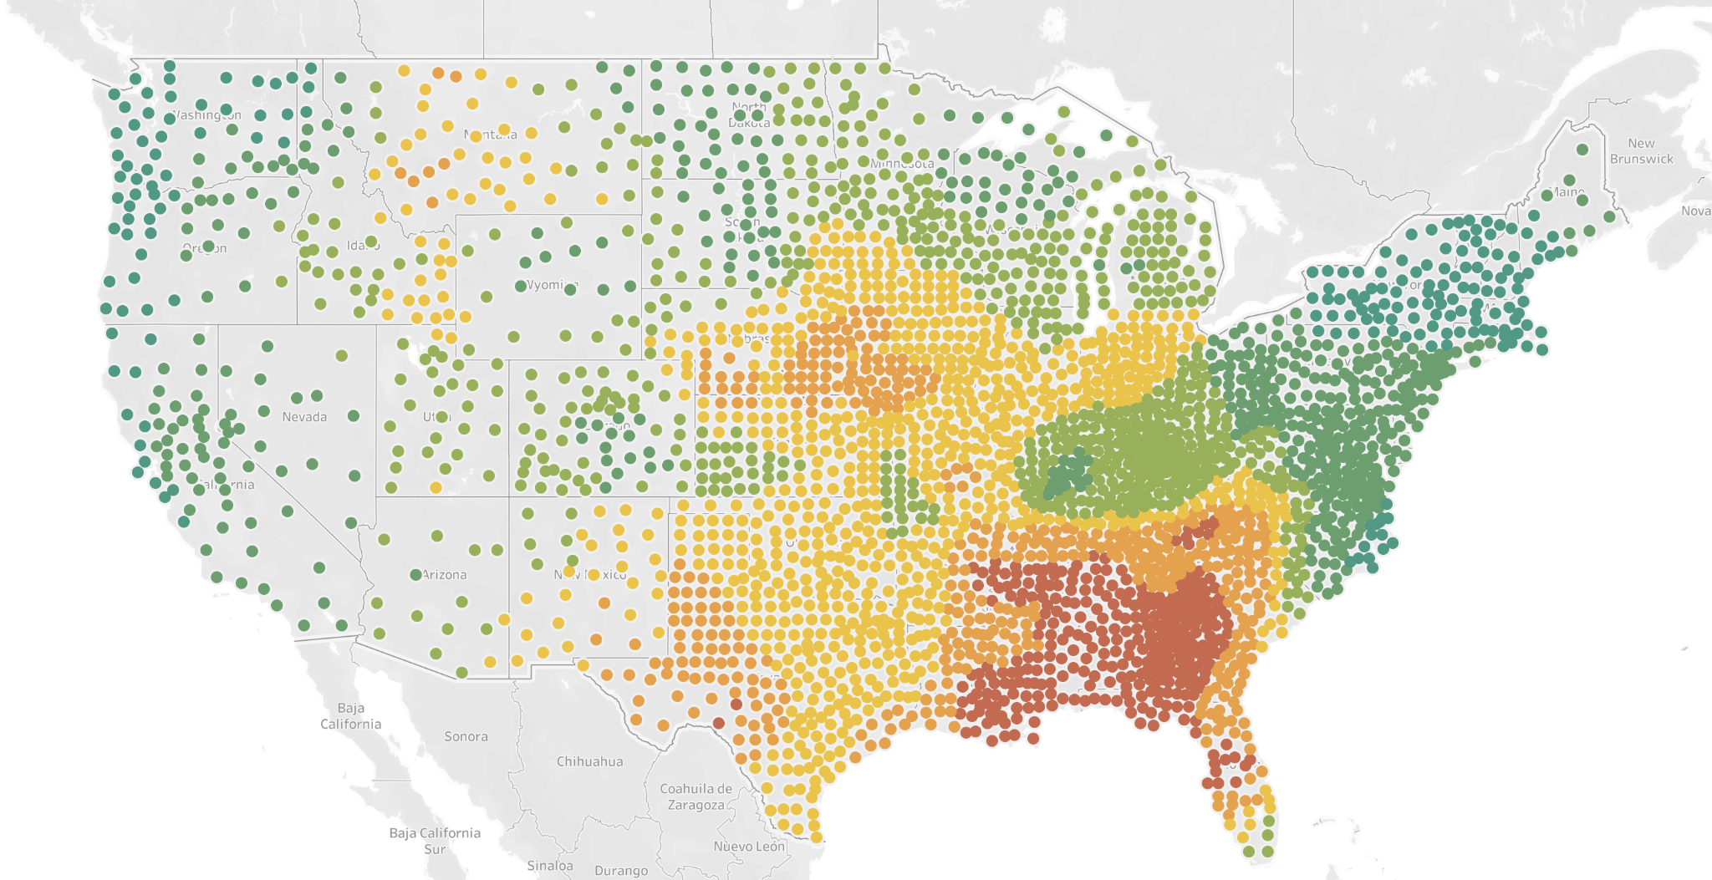
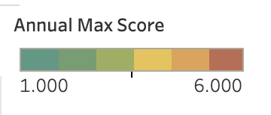
Interactive Map of Drought Scores
Visualization of the drought scores measured at each location over the 2 decades of samples
https://public.tableau.com/app/profile/amy.paschal/viz/DroughtDataAnnual/AnnualDroughtScores?publish=yes

Slide 10
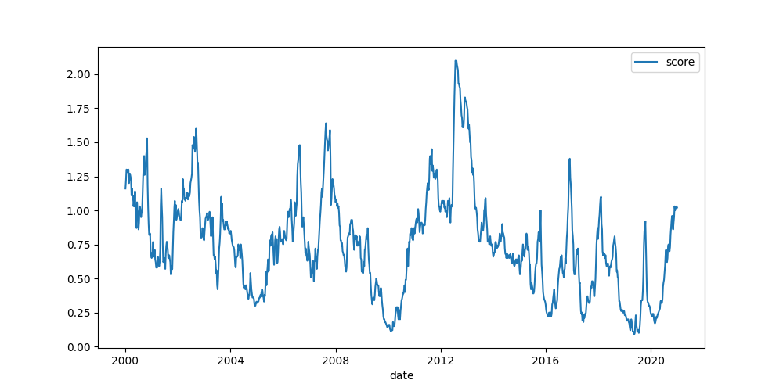
Time Series of Droughts

Slide 11
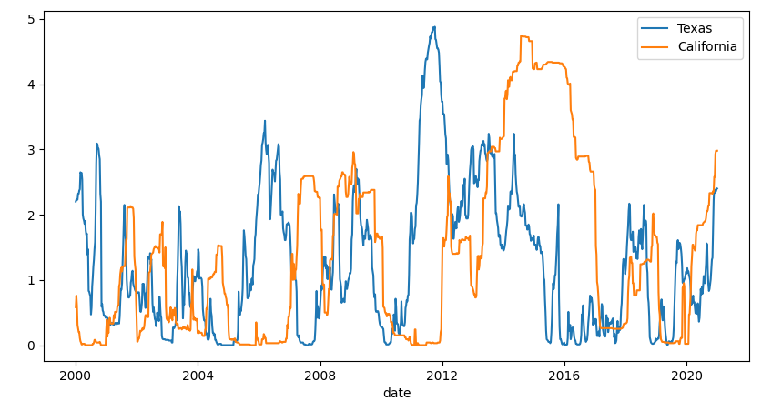
State Comparison of Droughts

Slide 12
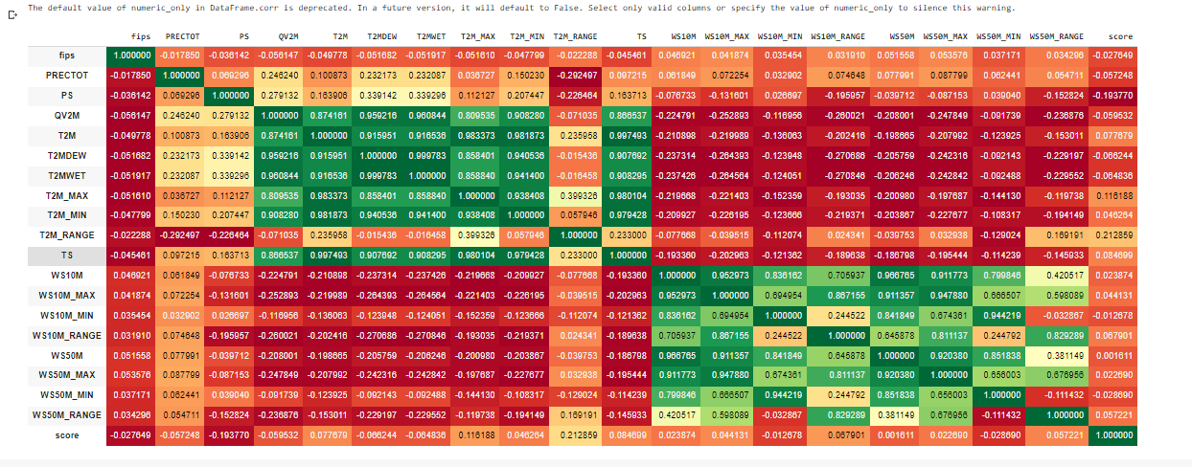
Correlation Within the Data

Slide 13
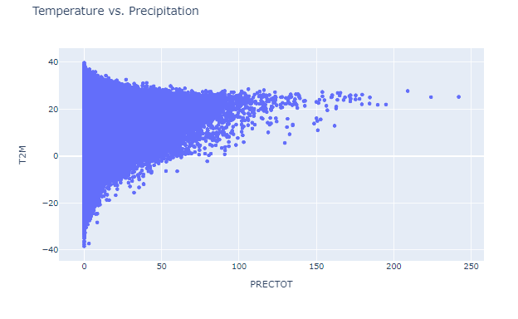
Temperature vs Precipitation

Slide 14
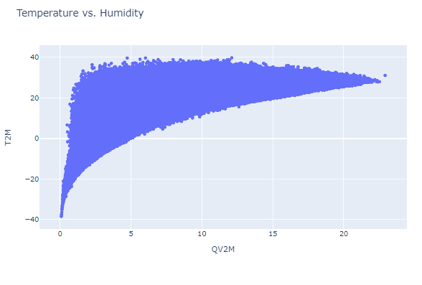
Temperature vs Humidity

Slide 15
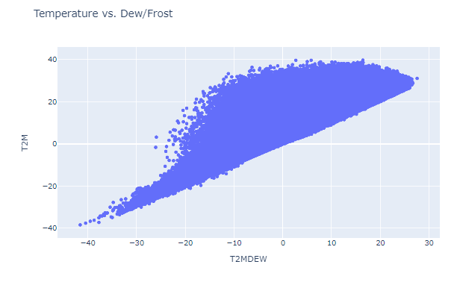
Temperature vs Dew/Frost

Slide 16
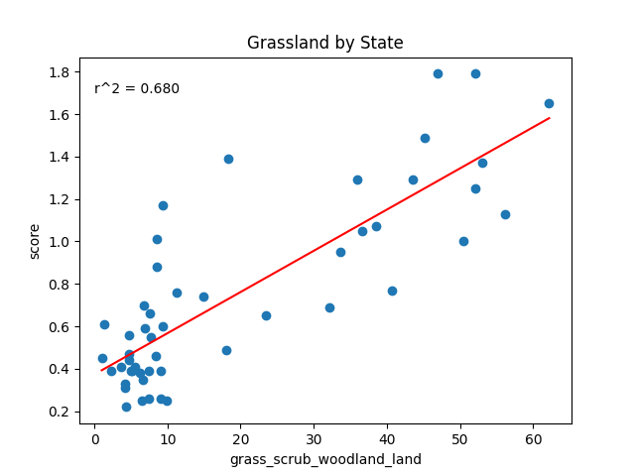
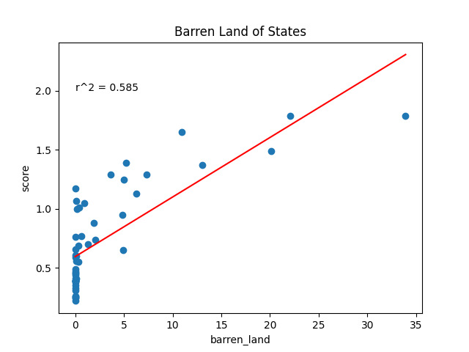
Linear Regressions with the Soil Data
Type of Land

Slide 17
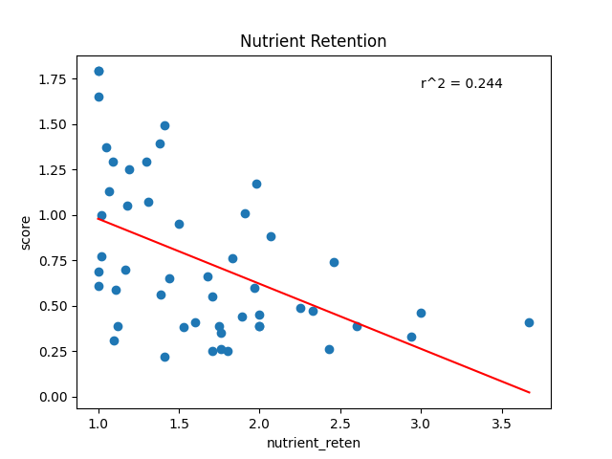
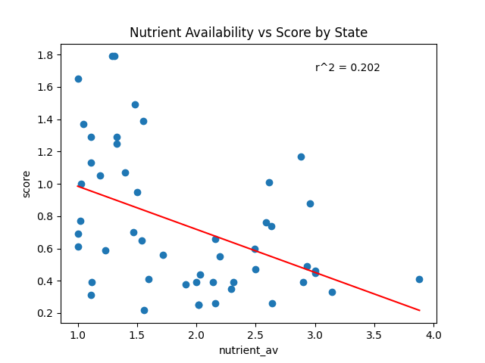
Linear Regressions with the Soil Data
Soil Features

Slide 18
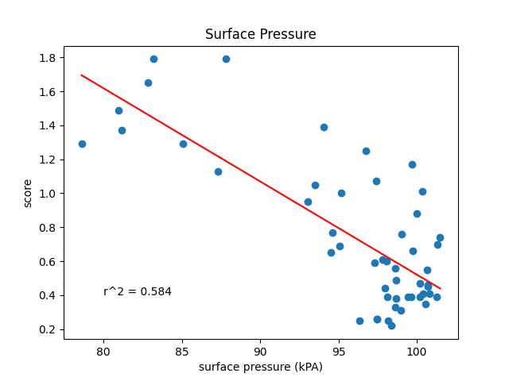
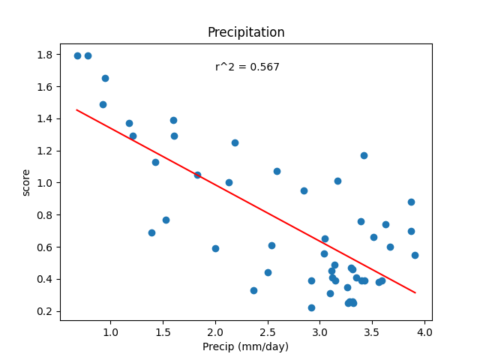
Linear Regressions with the Time Series Data

Slide 19
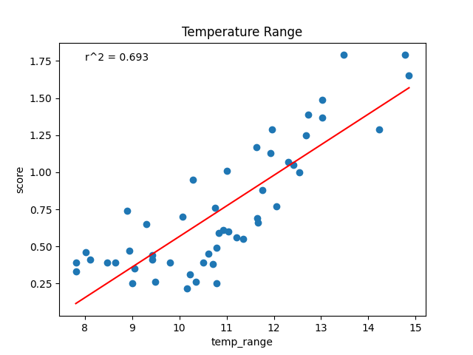
Linear Regressions with the Time Series Data

Slide 20
Machine Learning Model

Slide 21
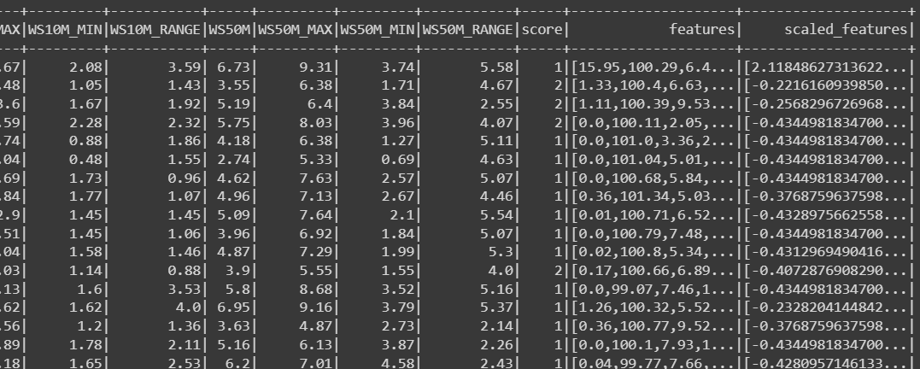
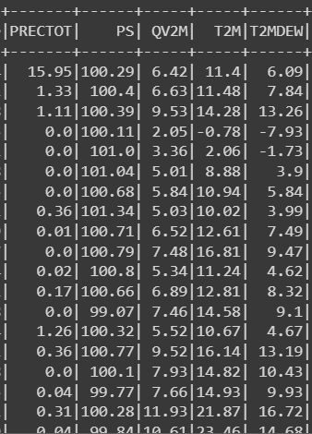
PySpark - Vector Assembler to Create Dense Vector Column

Slide 22
PySpark Machine Learning Algorithms Attempted
Multilayer Perceptron Classifier
Linear Regression Model
Decision Tree Regressor
Random Forest Regressor
Random Forest Classifier
- Rounded Scores to create five bins
- Kept giving errors during evaluation
- Root Mean Squared Error (RMSE) of 0.5846…
- Didn’t produce feature importance
RMSE = 0.590201
Mean Squared Error (MSE) = 0.348337
Mean Absolute Error (MAE) = 0.38777
R Squared (R2) = -0.00464572
Similar results to Decision Tree Regressor
- Rounded scores
- Produced Feature Importance
- Accuracy of 0.7591

